Slide 1
Submitted to:
Dr. Sheikh Muhammad Allayear
Assistant Professor,
CSE Dept.
Submitted by:
Nusrat Jahan Eka
ID: 2013-1-60-13

Slide 2
Project Name
Address Book Management

Slide 3
Project Outline:
Add info
Update info
Search info
Delete info
Display info

Slide 4
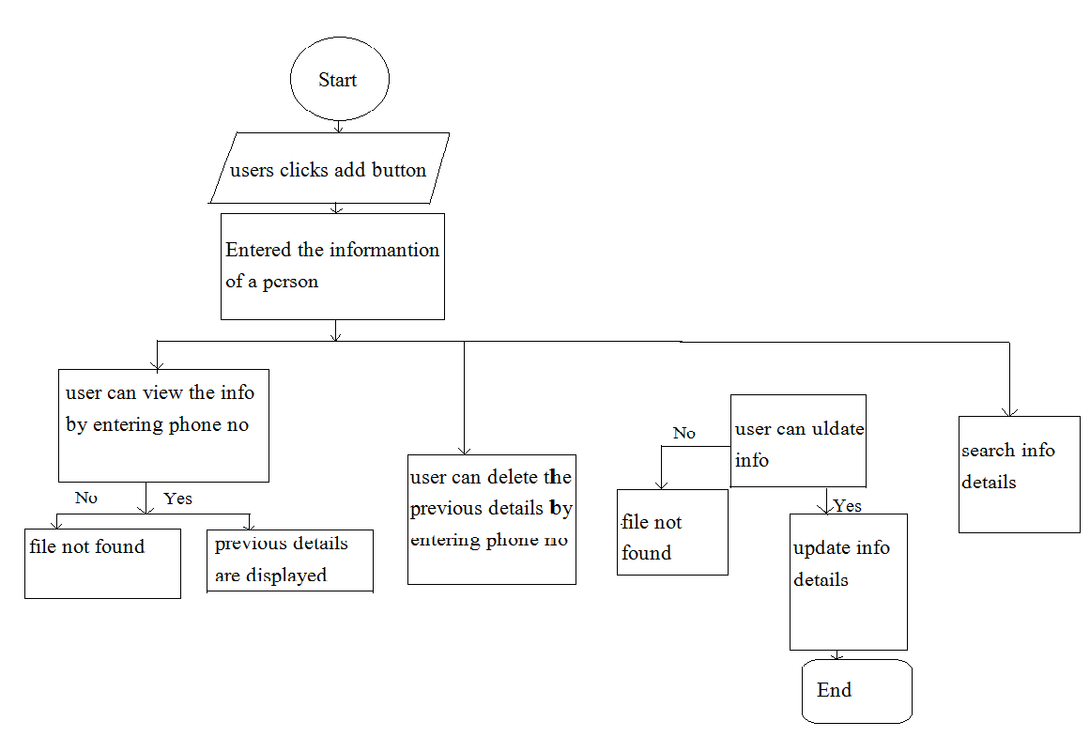
Flowchart

Slide 5
Thank you

